Slide 1
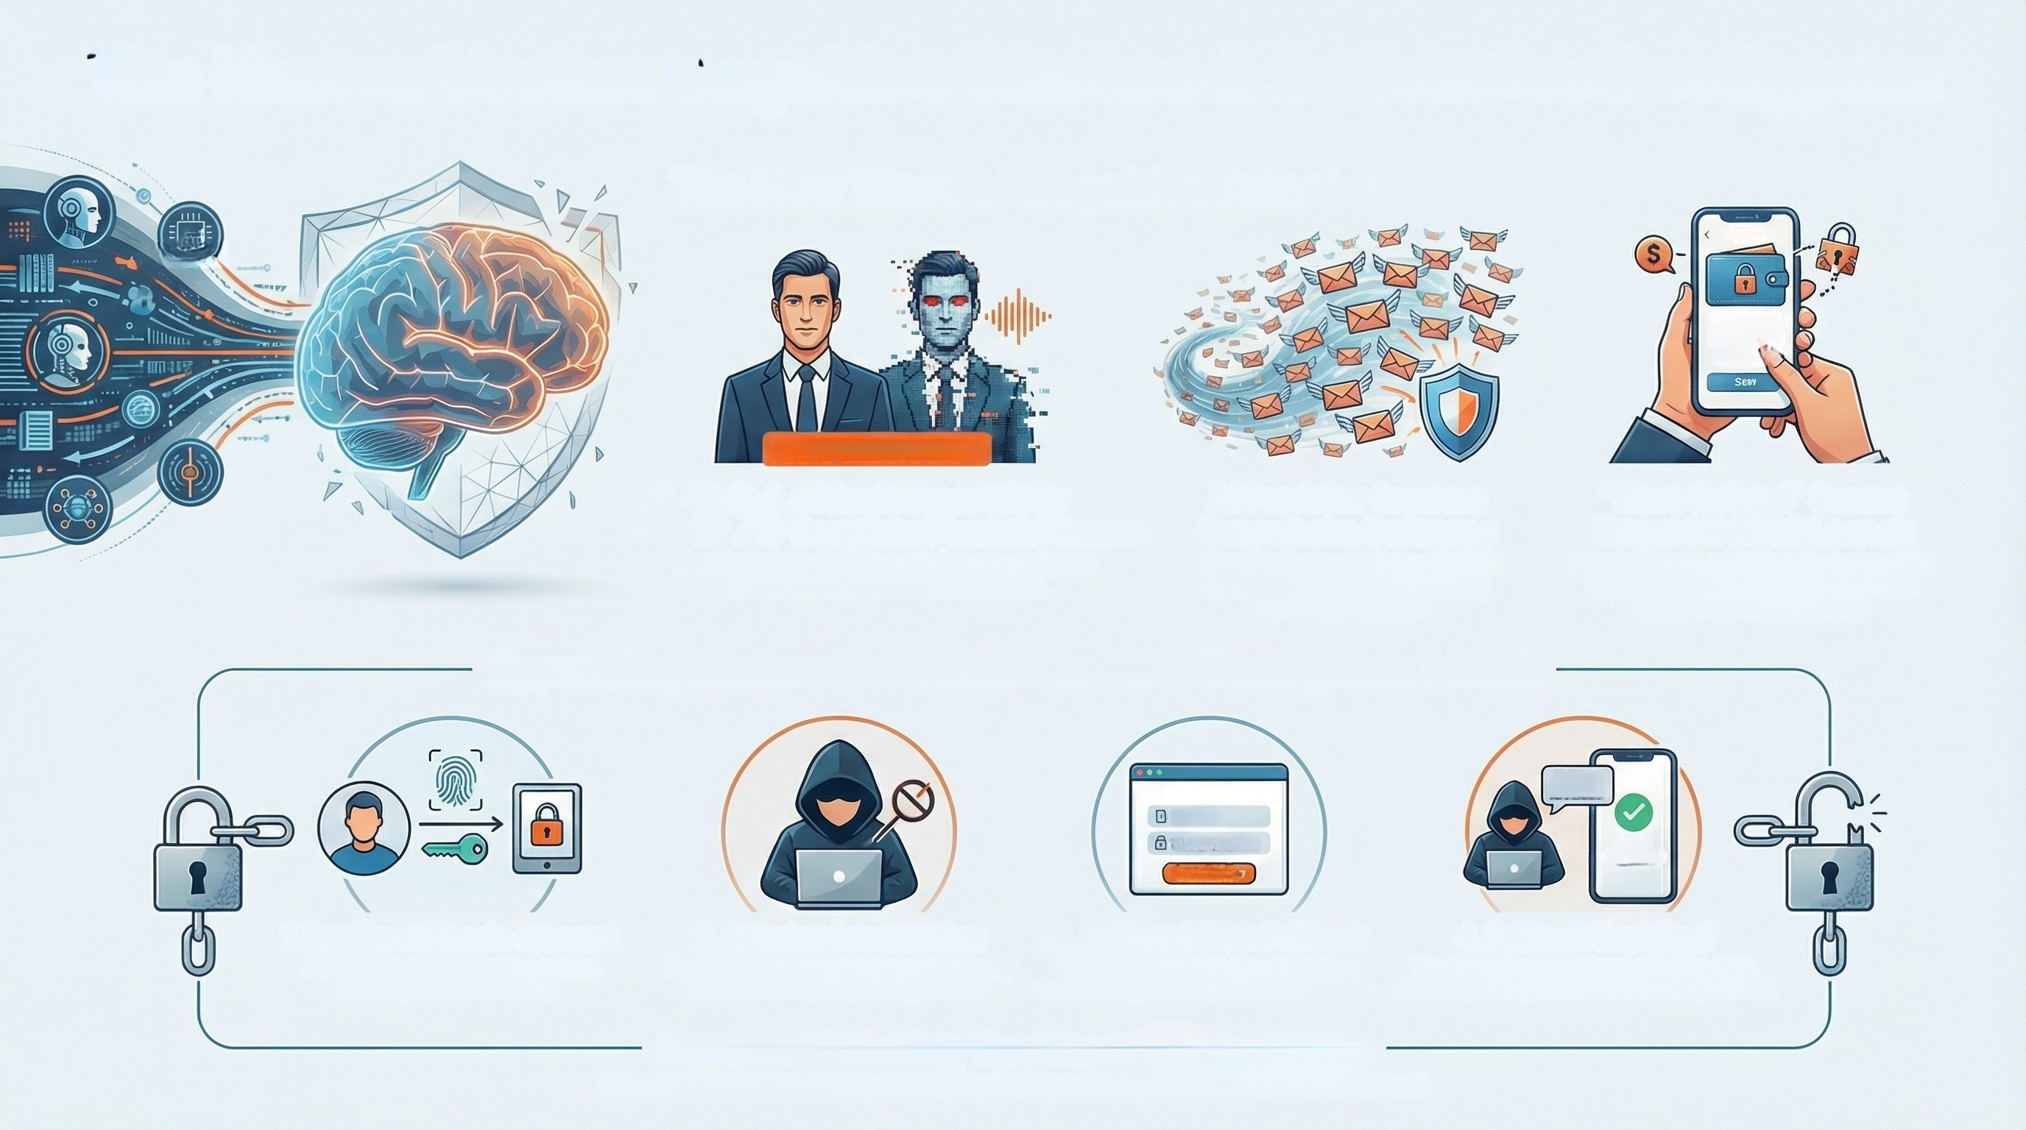
The Human Vector: Cognitive Warfare & Authentication Bypass
The New Wave of Cognitive Attacks
Al
Wolot
THE
Were Refund
HT 2028
Launch
AI IMPERSONATION
43%
of Businesses Hit by
Deepfake Financial Scams
Fraudsters use C-suite audio impersonation to
authorize fraudulent fund transfers.
Al Predator Swarms
Overwhelm Defenses
Agentic Al can send over 10,000
unique, context-aware phishing
emalls per second
"Wero Refund" Scams
Target H1 2026 Launch
Fraudsters are exploiting the irreversible
nature of instant payments with new
social engineering tactics.
Bypassing Modern Defenses: The FIDO Downgrade Attack
HUE ceer
Try another options
SMS CODE
SMS Code
Security Questions
Login
Successful
Try Attacay way
1. Legitimate Login Attempt
A user initiates a login using a secure,
phishing-resistant Passkey.
2. Attacker Intervention
The attacker intentionally blocks the Passkey
authentication path, causing it to fail.
3. System Offers Fallback
The service prompts the user to "Try
another way," offering less secure options.
4. Fallback Exploited
The user selects a weaker method like SMS,
and the attacker phishes the one-time password.
Renders "Phishing-Resistant" MFA Useless
This attack bypasses strong security by forcing a downgrade to a vulnerable method.

Slide 2
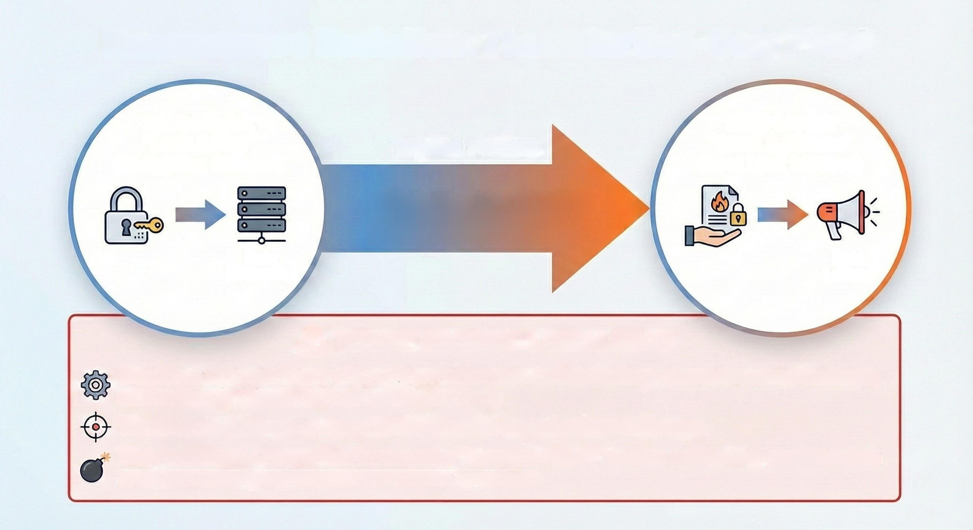
Ransomware Evolution: The Extortion-Only Pivot
2023 Model:
"Lock & Key"
(Encryption focused)
2025 Model:
"Steal & Shame"
(Data Leak focused)
Tripled Victims
12% SHIFT
Data
Encrypted
Data
Leaked
A THREAT ANALYSIS & ESCALATION
The Pivot: Attacker focus shifted from encryption to data leakage due to improved backups;
extortion-only attacks tripled to 12% of cases.
The Hunter: Akira group targeted 34 financial organizations in Europe.
The Escalation: Groups like Qilin employ "Scorched Earth" tactics, exfiltrating sensitive data
and then destroying servers to maximize pressure.

Slide 3
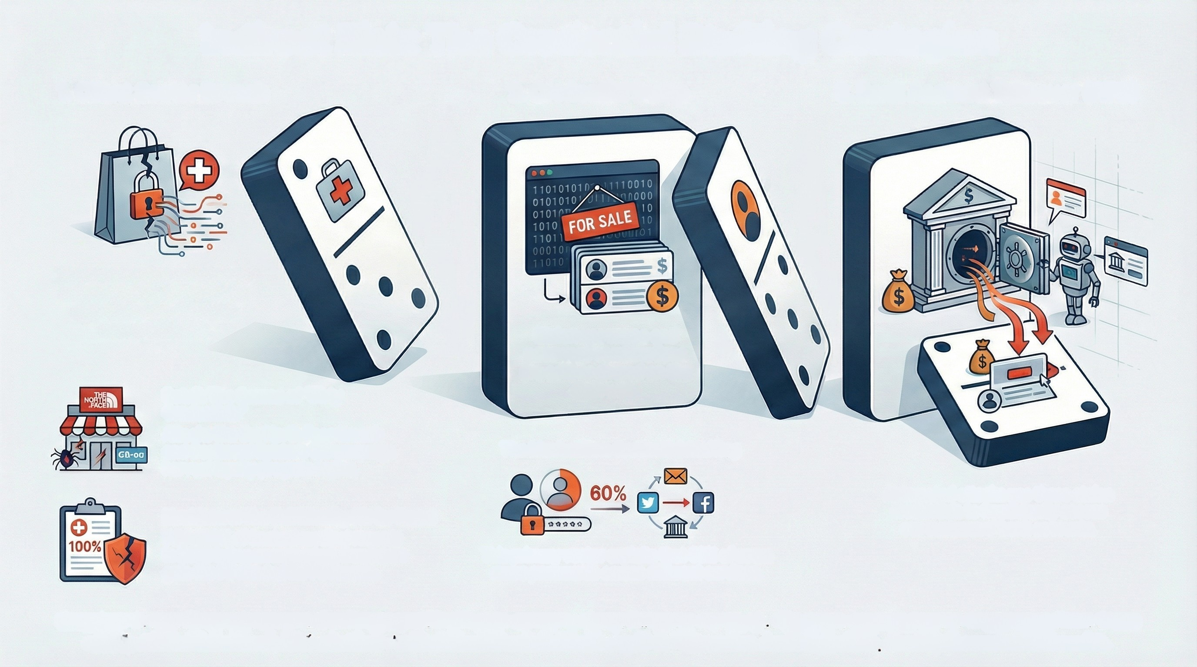
Indirect Risk: The Credential Stuffing Contagion
1. Client Sector Breach
2. Credential Dump
3. Bank Account Takeover (ATO)
Threat actors target retailers
and healthcare providers to
steal mass quantities of
user credentials.
Stolen username and
password combinations
are sold or shared on the
dark web.
Retail: The Source of "Dirty
Credentials"
Attacks like the North Face breach
and Scattered Spider's UK campaign
harvest loyalty program logins.
The Mechanism: Credential Stuffing
Automated attacks use these stolen
credentials to fraudulently access
our customers' bank accounts.
Healthcare: The Full Identity Kit for Fraud
With 100% of hacked medical records
in 2025 being unencrypted, fraudsters
gain the PII needed for PIN resets.
This primary vector exploits that 60% of users
reuse passwords across different services.
Breaches in non-financial sectors like Retail and Healthcare create a direct threat to our bank. Attackers steal customer credentials from these
weakly-defended sectors and use them to launch automated attacks against high-value banking portals, leading to account takeovers.

